Slide 1
Chapter 2 Elementary Programming

Slide 2
Objectives
To write programs that perform simple computations.
To obtain input from a program’s user by using the input function.
To use identifiers to name variables.
To assign data to variables.
To define named constants.
To use the operators +, -, *, /, //, %, and ** .
To write and evaluate numeric expressions.
To use augmented assignment operators to simplify coding.
To perform numeric type conversion with the int and float functions.
To obtain the current system time by using time.time().

Slide 3
Objectives
To learn about turtle module.
To compute and display the distance between two points.
To explain the importance of, and provide examples of, proper programming style and documentation .
To explain the differences between syntax errors, runtime errors, and logic errors.
To create a basic graphics program using Turtle.

Slide 4
Statement
A statement represents an action or a sequence of actions. The statement print("Welcome to Python") in the below program is a statement that displays the greeting “Welcome to Python”.
Statements in a program execute in the order that they appear
From top to bottom
# Display two messages
print("Welcome to Python")
print("Python is fun")

Slide 5
Indentation
The indentation matters in Python. Note that the statements are entered from the first column in the new line. It would cause an error if the program is typed as follows:
# Display two messages
print("Welcome to Python")
print("Python is fun")

Slide 6
Comments
Comments: notes of explanation within a program
Ignored by Python interpreter
Intended for a person reading the program’s code
Begin with a # character
End-line comment: appears at the end of a line of code
Typically explains the purpose of that line

Slide 7
Proper Comments and Spacing
Comments
Include your name and date at the beginning of the program.
Include a summary to explain what the program does.
Spacing
Use blank line to separate segments of the code.

Slide 8
Input, Processing, and Output
Typically, computer performs three-step process
Receive input
Assignment statements: any data that the program receives before it is running
Input: any data that the program receives while it is running
Perform some process on the data
Example: mathematical calculation
Produce output

Slide 9
Displaying Output with the print Function
Function: piece of prewritten code that performs an operation
print function: displays output on the screen
Argument: data given to a function
Example: data that is printed to screen

Slide 10
Displaying Multiple Items with the print Function
Python allows one to display multiple items with a single call to print
Items are separated by commas when passed as arguments
Arguments displayed in the order they are passed to the function
Items are automatically separated by a space when displayed on screen

Slide 11
Numeric Data Types, Literals, and the str Data Type
Data types:
e.g., int for integer, float for real number, str used for storing strings in memory

Slide 12
Strings and String Literals
String: sequence of characters that is used as data
String literal: string that appears in actual code of a program
Must be enclosed in single (‘) or double (“) quote marks
String literal can be enclosed in triple quotes (''' or """)
Enclosed string can contain both single and double quotes and can have multiple lines

Slide 13
Strings and String Literals
'A' Same as "A“
'4' Same as "4“
"Good morning" Same as 'Good morning'

Slide 14
Numeric Literals
Numeric literal: number written in a program
No decimal point considered int, otherwise, considered float
Some operations behave differently depending on data type
Examples:
integer: e.g., 3, 4
float: e.g., 3.0, 4.0

Slide 15
Variables
Variable: name that represents a value stored in the computer memory
Used to access and manipulate data stored in memory
A variable references the value it represents
Assignment statement: used to create a variable and make it reference data
General format is variable = expression
Example: age = 29
Assignment operator: the equal sign (=)

Slide 16
Variables (cont’d.)
In assignment statement, variable receiving value must be on left side
Variable name should not be enclosed in quote marks
You can only use a variable if a value is assigned to it

Slide 17
Variable Naming Rules
Rules for naming variables in Python:
Variable name cannot be a Python key word
Variable name cannot contain spaces
First character must be a letter or an underscore
After first character may use letters, digits, or underscores
Variable names are case sensitive
Variable name should reflect its use

Slide 18
Python Reserved Words
and | del | from | not | while
as | elif | global | or | with
assert | else | if | pass | yield
break | except | import | print
class | exec | in | raise
continue | finally | is | return
def | for | lambda | try

Slide 19
Variable Assignment: Example
# Assign a radius
radius = 20 # radius is now 20
# Compute area
area = radius * radius * 3.14159
# Display results
print("The area for the circle of radius", radius, "is", area)

Slide 20
Trace a Program Execution
Assign 20 to radius
# Assign a radius
radius = 20 # radius is now 20
# Compute area
area = radius * radius * 3.14159
# Display results
print("The area for the circle of radius",
radius, "is", area)
radius
20

Slide 21
Trace a Program Execution
Assign result to area
# Assign a radius
radius = 20 # radius is now 20
# Compute area
area = radius * radius * 3.14159
# Display results
print("The area for the circle of radius",
radius, "is", area)
radius
20
area
1256.636

Slide 22
Trace a Program Execution
print a message to the console
# Assign a radius
radius = 20 # radius is now 20
# Compute area
area = radius * radius * 3.14159
# Display results
print("The area for the circle of radius",
radius, "is", area)
radius
20
area
1256.636
The area for the circle of radius 20 is 1256.636

Slide 23
Variable Reassignment
Variables can reference different values while program is running
A variable can refer to item of any type
Variable that has been assigned to one type can be reassigned to another type

Slide 24
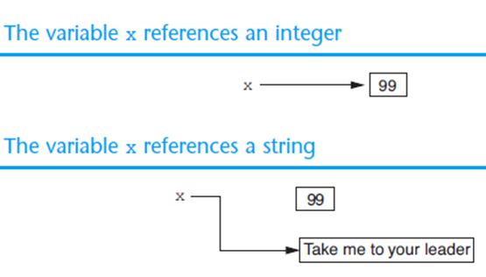
Reassigning a Variable to a Different Type
A variable in Python can refer to items of any type
x = 99
x = “Take me to your leader”

Slide 25
Named Constants
The value of a variable may change during the execution of a program, but a named constant or simply constant represents permanent data that never changes. Python does not have a special syntax for naming constants. You can simply create a variable to denote a constant. To distinguish a constant from a variable, use all uppercase letters to name a constant.

Slide 26
Reading Input from the Keyboard
Most programs need to read input from the user
Built-in input function reads input from keyboard
Returns the data as a string
Format: variable = input(prompt)
prompt is typically a string instructing user to enter a value
Does not automatically display a space after the prompt

Slide 27
Reading Input from the Keyboard (cont’d.)
input function always returns a string
Built-in functions convert between data types
int(item) converts item to an int
float(item) converts item to a float
Nested function call: general format: function1(function2(argument))
value returned by function2 is passed to function1
Type conversion only works if item is valid numeric value, otherwise, generates an error

Slide 28
Reading Input from the Keyboard: Example
# Prompt the user to enter a radius
radius = float(input("Enter a number for radius: "))
# Compute area
area = radius * radius * 3.14159
# Display results
print("The area for the circle of radius", radius, "is", area)
Enter a number for radius: 5.5
The area for the circle of radius 5.5 is 95.0330975
Compute Area With Console Input
# Prompt the user to enter three numbers
number1 = float(input("Enter the first number: "))
number2 = float(input("Enter the second number: "))
number3 = float(input("Enter the third number: "))
# Compute average
average = (number1 + number2 + number3) / 3
# Display result
print("The average of", number1, number2, number3, "is", average)
Enter the first number: 3
Enter the second number: 7
Enter the third number: 5
The average of 3.0 7.0 5.0 is 5.0
Compute Average

Slide 29
Performing Calculations
Math expression: performs calculation and gives a value
Math operator: tool for performing calculation
Operands: values surrounding operator
Variables can be used as operands
Resulting value typically assigned to variable
Two types of division:
/ operator performs floating point division
// operator performs integer division
results truncated

Slide 30
Numeric Operators

Slide 31
Order of Operations
Python operator precedence:
Operations enclosed in parentheses
Forces operations to be performed before others
Exponentiation (**)
Multiplication (*), division (/ and //), and remainder (%)
Addition (+) and subtraction (-)
Higher precedence performed first
Same precedence operators execute from left to right

Slide 32
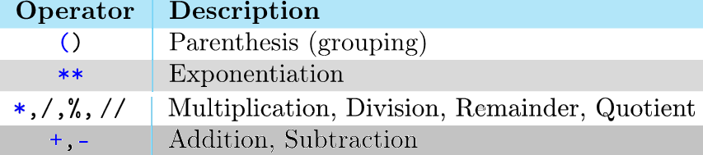
Order of Operations (cont’d.)

Slide 33
The Exponent Operator and the Remainder Operator
Exponent operator (**): Raises a number to a power
x ** y = x^{y}
Remainder operator (%): Performs division and returns the remainder
a.k.a. modulus operator
e.g., 4%2=0, 5%2=1
Typically used to convert times and distances, and to detect odd or even numbers

Slide 34
The % Operator

Slide 35
Remainder Operator
Remainder is very useful in programming. For example, an even number % 2 is always 0 and an odd number % 2 is always 1. So you can use this property to determine whether a number is even or odd.
Suppose today is Saturday and you and your friends are going to meet in 10 days. What day is in 10 days? You can find that day is Tuesday using the following expression:

Slide 36
Problem: Displaying Minutes and Seconds
Write a program that obtains minutes and remaining seconds from seconds.
# Prompt the user for input
seconds = int(input("Enter an integer for seconds: "))
# Get minutes and remaining seconds
minutes = seconds // 60 # Find minutes in seconds
remainingSeconds = seconds % 60 # Seconds remaining
print(seconds, "seconds is", minutes, "minutes and", remainingSeconds, "seconds")
Enter an integer for seconds: 10055
10055 seconds is 167 minutes and 35 seconds
Display Time

Slide 37
Problem: Displaying Current Time
Write a program that displays current time in GMT in the format hour:minute:second such as 1:45:19.
The time.time() function returns the current time in seconds with millisecond precision since the midnight, January 1, 1970 GMT. (1970 was the year when the Unix operating system was formally introduced.) You can use this function to obtain the current time, and then compute the current second, minute, and hour as follows.

Slide 38
Problem: Displaying Current Time
# Imports all functions defined in the time module and makes them available for you to use.
import time
currentTime = time.time() # Get current time
# Obtain the total seconds since midnight, Jan 1, 1970
totalSeconds = int(currentTime)
# Get the current second
currentSecond = totalSeconds % 60
# Obtain the total minutes
totalMinutes = totalSeconds // 60
# Compute the current minute in the hour
currentMinute = totalMinutes % 60
# Obtain the total hours
totalHours = totalMinutes // 60
# Compute the current hour
currentHour = totalHours % 24
# Display results
print("Current time is", currentHour, ":",currentMinute, ":", currentSecond, "GMT")
Current time is 23 : 56 : 30 GMT
Show Current Time

Slide 39
Arithmetic Expressions
is translated to
(3+4*x)/5 – 10*(y-5)*(a+b+c)/x + 9*(4/x + (9+x)/y)
(3+4*x)/5 – 10*(y-5)*(a+b+c)/x + 9*(4/x + (9+x)/y)

Slide 40
How to Evaluate an Expression
Though Python has its own way to evaluate an expression behind the scene, the result of a Python expression and its corresponding arithmetic expression are the same. Therefore, you can safely apply the arithmetic rule for evaluating a Python expression.

Slide 41
Mixed-Type Expressions and Data Type Conversion
Data type resulting from math operation depends on data types of operands
Two int values: result is an int
Two float values: result is a float
int and float: int temporarily converted to float, result of the operation is a float
Type conversion of float to int causes truncation of fractional part

Slide 42
Augmented Assignment Operators
Operator Example Equivalent
+= i += 8 i = i + 8
-= f -= 8.0 f = f - 8.0
*= i *= 8 i = i * 8
/= i /= 8 i = i / 8
//= i //= 8 i = i // 8
%= i %= 8 i = i % 8

Slide 43
Built-in Functions
>>> max(2, 3, 4) # Returns a maximum number
4
>>> min(2, 3, 4) # Returns a minimu number
2
>>> round(3.51) # Rounds to its nearest integer
4
>>> round(3.4) # Rounds to its nearest integer
3
>>> abs(-3) # Returns the absolute value
3
>>> pow(2, 3) # Same as 2 ** 3
8

Slide 44
Printing without the Newline
print function displays line of output
Newline character at end of printed data
Special argument end=‘delimiter’ causes print to place delimiter at end of data instead of newline character
print function uses space as item separator
Special argument sep=‘delimiter’ causes print to use delimiter as item separator

Slide 45
Printing without the Newline (cont’d.)
print(item, end = 'anyendingstring')
print("AAA", end = ' ')
print("BBB", end = '')
print("CCC", end = '***')
print("DDD", end = '***')
AAA BBBCCC***DDD***

Slide 46
Escape Sequences for Special Characters
Special characters appearing in string literal
Preceded by backslash (\)
Examples: newline (\n), horizontal tab (\t)
print("AAA\tBBB")
print("CCC\nDDD")
AAA BBB
CCC
DDD

Slide 47
Escape Sequences for Special Characters (cont’d.)
Description Escape Sequence
Tab \t
Linefeed \n
Backslash \\
Single Quote \'
Double Quote \"

Slide 48
The String Concatenation Operator
You can use the + operator add two numbers. The + operator can also be used to concatenate (combine) two strings. Here are some examples:
message = "Welcome " + "to " + "Python"
print(message)
chapterNo = 2
s = "Chapter " + str(chapterNo)
print(s)
Welcome to Python
Chapter 2

Slide 49
String Formatting
Converting variables to strings and concatenating these strings together can be a tedious process.
Precision of values is not the same and the values are not aligned.
Python provides us with a better alternative: the format method.

Slide 50
Format Method
format is a method that creates a new string where certain elements of the string are formatted.
To understand string formatting, it is probably better to start with an example.
print("Sorry, is this the {} minute{}?". format(5, 'ARGUMENT'))
prints Sorry, is this the 5 minuteARGUMENT

Slide 51
Map Args to {}
The curly braces {} serve as placeholders for values to be inserted into the string.
The string is modified so that the {} elements in the string are replaced by the format method arguments
The replacement is in order: first {} is replaced by the first argument, second {} by the second argument and so forth.

Slide 52
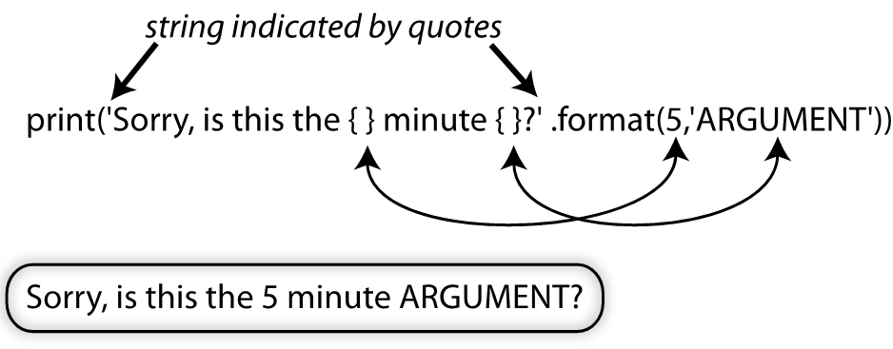
Map Args to {}

Slide 53
Format Specifier
The curly bracket includes format specifier of how to format particular argument.
Each bracket looks like
{position:alignmentWidthPrecisionType}
Position corresponds to argument position
align is optional (default left)
width is how many spaces (default just enough)
.precision is for floating point rounding (default no rounding)
type is the expected type (error if the arg is the wrong type)

Slide 54
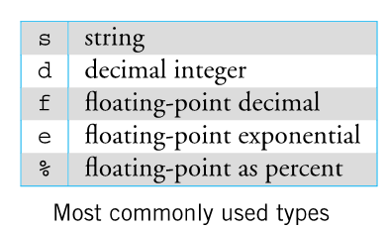
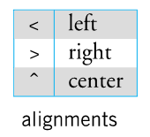
Conversion Specification
{position:alignmentWidthPrecisionType}

Slide 55
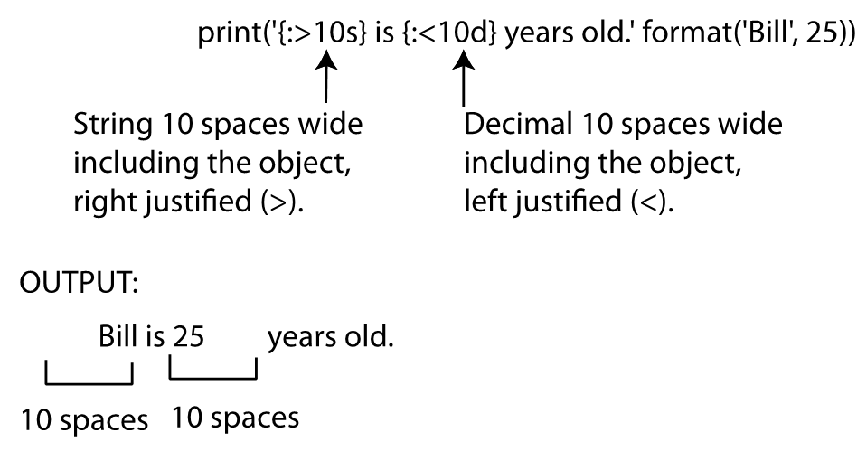
Demonstrating string formatting

Slide 56
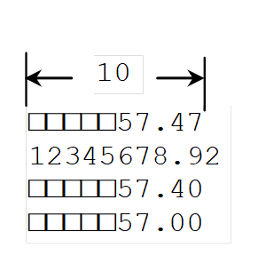
Formatting Floating-Point Numbers
print('{:10.2f}'.format(57.467657))
print('{:10.2f}'.format(12345678.923))
print('{:10.2f}'.format(57.4))
print('{:10.2f}'.format(57))

Slide 57
Formatting in Scientific Notation
If you change the conversion code from f to e, the number will be formatted in scientific notation. For example,
print('{0:10.2e}'.format(57.467))
print('{0:10.2e}'.format(0.0033923))
print('{0:10.2e}'.format(57.4))
print('{0:10.2e}'.format(57))

Slide 58
Formatting as a Percentage
You can use the conversion code % to format numbers as a percentage. For example,
print('{0:10.2%}'.format(0.53457))
print('{0:10.2%}'.format(0.0033923))
print('{0:10.2%}'.format(7.4))
print('{0:10.2%}'.format(57))

Slide 59
Justifying Format
By default, the format is right justified. You can put the symbol < in the format specifier to specify that the item is a left justified in the resulting format within the specified width. For example,
print('{0:10.2f}'.format(57.467657))
print('{0:<10.2f}'.format(57.467657))

Slide 60
Formatting Integers
You can use the conversion code d, x, o, and b to format an integer in decimal, hexadecimal, octal, or binary. You can specify a width for the conversion. For example,
print('{0:10d}'.format(59832))
print('{0:<10d}'.format(59832))

Slide 61
Formatting Strings
You can use the conversion code s to format a string with a specified width. For example,
print('{0:20s}'.format("Welcome to Python"))
print('{0:<20s}'.format("Welcome to Python"))
print('{0:>20s}'.format("Welcome to Python"))

Slide 62
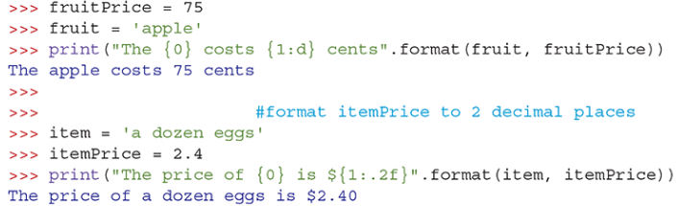
Demonstrating string formatting (cont’d.)

Slide 63
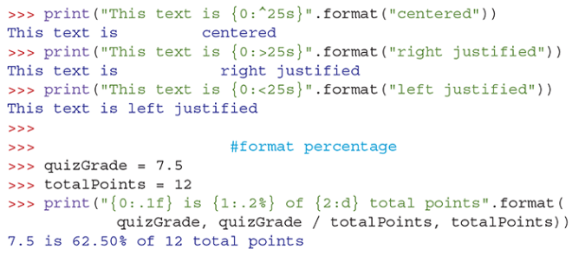
Demonstrating string formatting (cont’d.)

Slide 64
Problem: Computing Distances
This program prompts the user to enter two points, computes their distance, and displays the distance.

Slide 65
Problem: Computing Distances
# Enter the first point with two double values
x1 = float(input("Enter x-coordinate for Point 1: "))
y1 = float(input("Enter y-coordinate for Point 1: "))
# Enter the second point with two double values
x2 = float(input("Enter x-coordinate for Point 2: "))
y2 = float(input("Enter y-coordinate for Point 2: "))
# Compute the distance
distance = ((x2 - x1) ** 2 + (y2 - y1) ** 2) ** 0.5
print("The distance between the two points is {0:.1f}".format(distance))
Compute Distance
Enter x-coordinate for Point 1: 5.5
Enter y-coordinate for Point 1: 7.25
Enter x-coordinate for Point 2: -3.5
Enter y-coordinate for Point 2: -6.5
The distance between the two points is 16.4

Slide 66
Programming Errors
Syntax Errors
Error in code construction
Runtime Errors
Causes the program to abort
Logic Errors
Produces incorrect result

Slide 67
The Three Rules
Rule 1: Think before you program
Rule 2: A program is a human-readable essay on problem solving that also happens to execute on a computer
Rule 3: The best way to improve your programming and problem-solving skills is to practice.

Slide 68
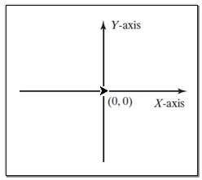
Graphics Programming
Turtle is Python’s built-in graphics module for drawing lines, circles, and other shapes, including text. It is easy to learn and simple to use.
Turtle has a number of characteristics:
A two-dimensional drawing screen
One (or more) turtles; each turtle has:
A position
An orientation or direction
A pen, with attributes such as color, width, up/down, etc.

Slide 69
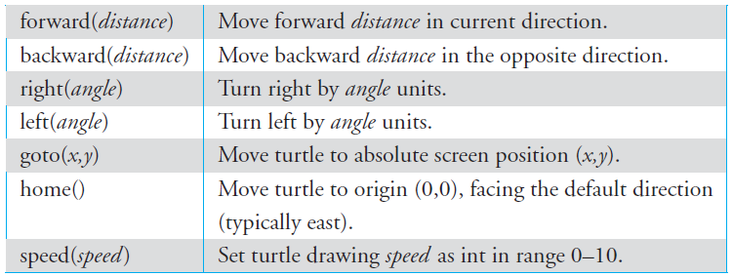
Turtle Movement Commands

Slide 70
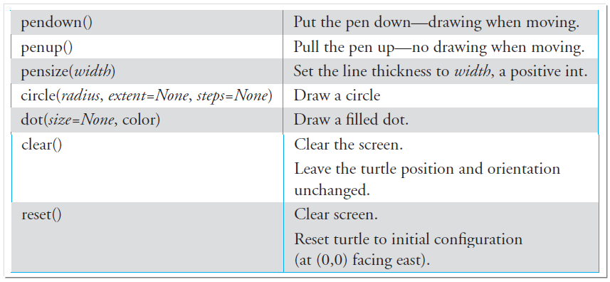
Turtle Drawing Commands

Slide 71
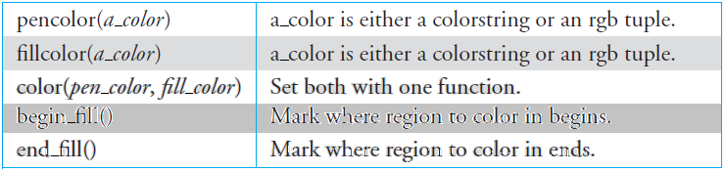
Turtle Pen Commands

Slide 72
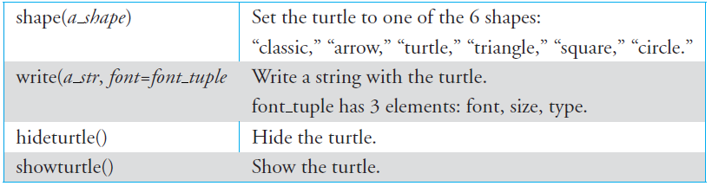
Turtle Other Commands

Slide 73
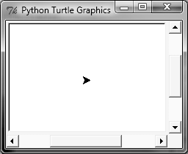
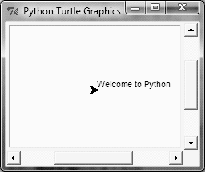
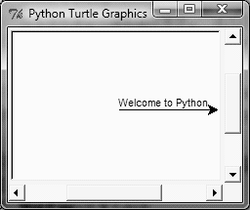
Introduction to turtle
#imports all functions defined in the turtle module
>>> import turtle
#show the current location and direction of the turtle
>>> turtle.showturtle()
#draw a text string
>>> turtle.write("Welcome to Python")
#move the arrowhead 100 pixels forward
>>> turtle.forward(100)

Slide 74
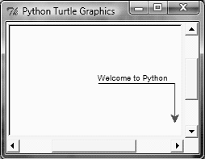
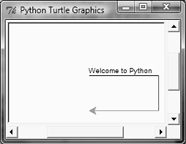

#turn the arrowhead right 90 degrees, change the turtle’s color to red,
#and move the arrowhead 50 pixels forward to draw a line
>>> turtle.right(90)
>>> turtle.color("red")
>>> turtle.forward(50)
#turn the arrowhead right 90 degrees, set the color to green,
#and move the arrowhead 100 pixels forward to draw a line
>>> turtle.right(90)
>>> turtle.color("green")
>>> turtle.forward(100)
#turn the arrowhead right 45 degrees and move it 80 pixels forward to draw a line
>>> turtle.right(45)
>>> turtle.forward(80)

Slide 75
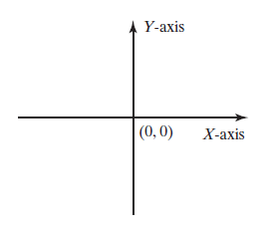
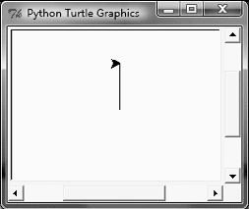
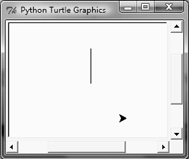
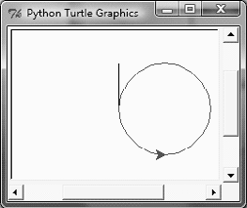
Moving the turtle to Any Location
#move the pen to (0, 50) from (0, 0),
>>> import turtle
>>> turtle.goto(0, 50)
#move the pen to (50, -50),
>>> turtle.penup()
>>> turtle.goto(50, -50)
>>> turtle.pendown()
#draw a circle with radius 50
>>> turtle.color("red")
>>> turtle.circle(50)

Slide 76
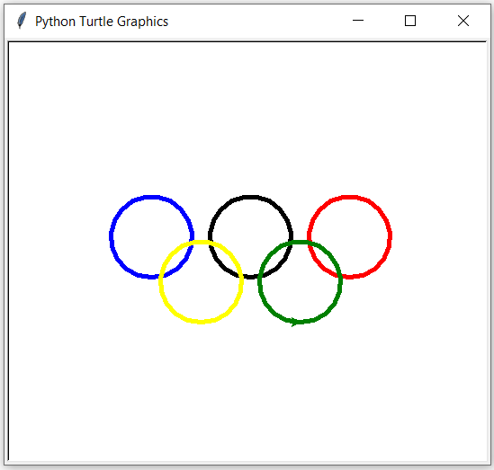
Drawing the Olympic Rings Logo
import turtle
turtle.pensize(5)
turtle.color("blue")
turtle.penup()
turtle.goto(-110, -25)
turtle.pendown()
turtle.circle(45)
turtle.color("black")
turtle.penup()
turtle.goto(0, -25)
turtle.pendown()
turtle.circle(45)
turtle.color("red")
turtle.penup()
turtle.goto(110, -25)
turtle.pendown()
turtle.circle(45)
turtle.color("yellow")
turtle.penup()
turtle.goto(-55, -75)
turtle.pendown()
turtle.circle(45)
turtle.color("green")
turtle.penup()
turtle.goto(55, -75)
turtle.pendown()
turtle.circle(45)
turtle.done()

Slide 77
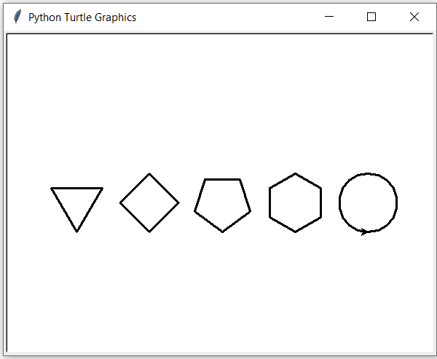
Problem: Draw Simple Shapes
import turtle
turtle.pensize(3)
turtle.penup()
turtle.goto(-200, -50)
turtle.pendown()
turtle.circle(40, steps = 3) # Draw a triangle
turtle.penup()
turtle.goto(-100, -50)
turtle.pendown()
turtle.circle(40, steps = 4) # Draw a square
turtle.penup()
turtle.goto(0, -50)
turtle.pendown()
turtle.circle(40, steps = 5) # Draw a pentagon
turtle.penup()
turtle.goto(100, -50)
turtle.pendown()
turtle.circle(40, steps = 6) # Draw a hexagon
turtle.penup()
turtle.goto(200, -50)
turtle.pendown()
turtle.circle(40) # Draw a circle
turtle.done()
Simple Shapes

Slide 78
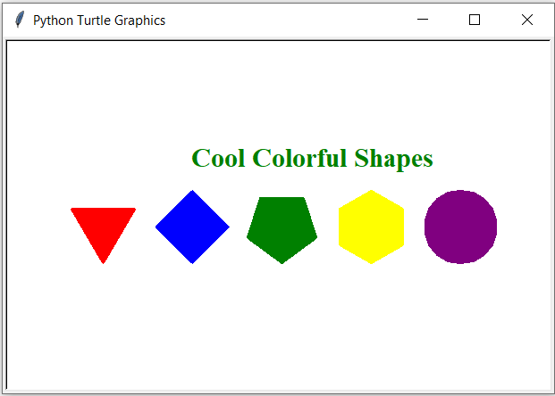
import turtle
turtle.pensize(3) # Set pen thickness to 3 pixels
turtle.penup() # Pull the pen up
turtle.goto(-200, -50)
turtle.pendown() # Pull the pen down
turtle.begin_fill() # Begin to fill color in a shape
turtle.color("red")
turtle.circle(40, steps = 3) # Draw a triangle
turtle.end_fill() # Fill the shape
turtle.penup()
turtle.goto(-100, -50)
turtle.pendown()
turtle.begin_fill() # Begin to fill color in a shape
turtle.color("blue")
turtle.circle(40, steps = 4) # Draw a square
turtle.end_fill() # Fill the shape
turtle.penup()
turtle.goto(0, -50)
turtle.pendown()
turtle.begin_fill() # Begin to fill color in a shape
turtle.color("green")
turtle.circle(40, steps = 5) # Draw a pentagon
turtle.end_fill() # Fill the shape
turtle.penup()
turtle.goto(100, -50)
turtle.pendown()
turtle.begin_fill() # Begin to fill color in a shape
turtle.color("yellow")
turtle.circle(40, steps = 6) # Draw a hexagon
turtle.end_fill() # Fill the shape
turtle.penup()
turtle.goto(200, -50)
turtle.pendown()
turtle.begin_fill() # Begin to fill color in a shape
turtle.color("purple")
turtle.circle(40) # Draw a circle
turtle.end_fill() # Fill the shape
turtle.color("green")
turtle.penup()
turtle.goto(-100, 50)
turtle.pendown()
turtle.write("Cool Colorful Shapes",
font = ("Times", 18, "bold"))
turtle.hideturtle()
turtle.done()
Color Shapes

Slide 79
Computing Distances
This program prompts the user to enter two points, computes their distance, and displays the points and their distances in graphics.

Slide 80
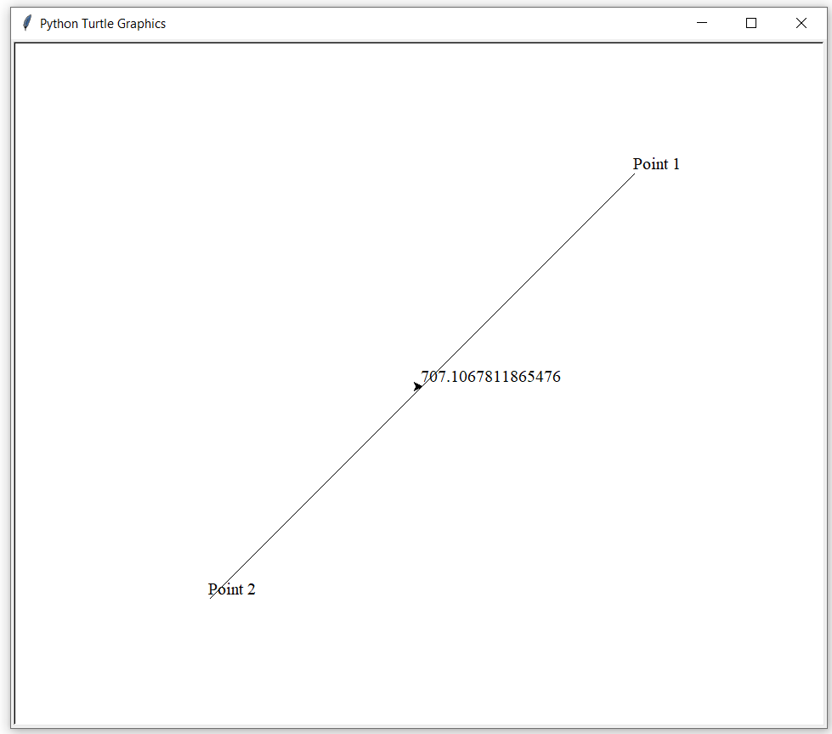
import turtle
# Prompt the user for inputing two points
x1 = float(input("Enter x-coordinate for Point 1: "))
y1 = float(input("Enter y-coordinate for Point 1: "))
x2 = float(input("Enter x-coordinate for Point 2: "))
y2 = float(input("Enter y-coordinate for Point 2: "))
# Compute the distance
distance = ((x2 - x1) ** 2 + (y2 - y1) ** 2) ** 0.5
# Display two points and the connecting line
turtle.penup()
turtle.goto(x1, y1) # Move to (x1, y1)
turtle.pendown()
turtle.write("Point 1", font=("Times", 12))
turtle.goto(x2, y2) # draw a line to (x2, y2)
turtle.write("Point 2", font=("Times", 12))
# Move to the center point of the line
turtle.penup()
turtle.goto((x1 + x2) / 2, (y1 + y2) / 2)
turtle.write(distance, font=("Times", 12))
turtle.done()
Compute Distance Graphics
Enter x-coordinate for Point 1: 250
Enter y-coordinate for Point 1: 250
Enter x-coordinate for Point 2: -250
Enter y-coordinate for Point 2: -250

